Slide 1
Strategic Removal of Lockdowns in Pandemic

Slide 2

SIR Model
S : Susceptible
I : Infected
R : Recovered / Removed
$\frac{dS}{dt}=−\frac{βSI}{N}$
$\frac{dI}{dt}=\frac{βSI}{N}−γI$
$\frac{dR}{dt}=γI$

Slide 3
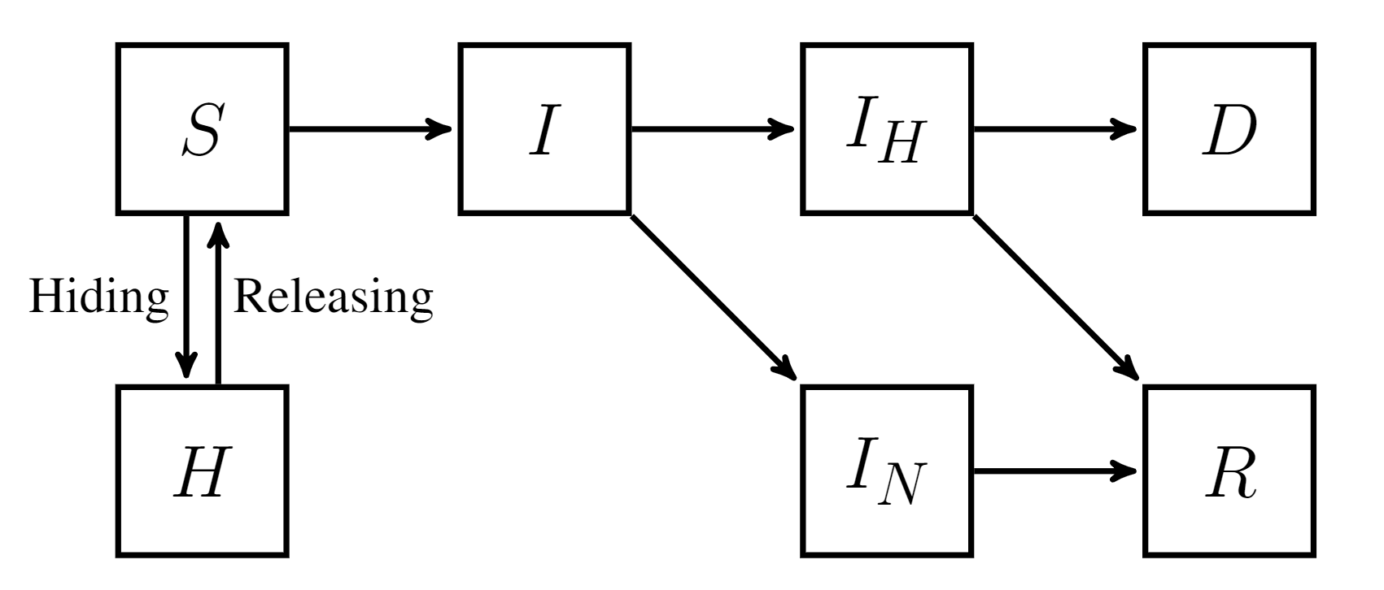

Extended Model
S : Susceptible
H : Hiding
I : Infected
R : Recovered
$I_{H}$ : Hospitalized
$I_{N}$ : Non-hospitalized
D : Death
R : Recovered
Notes:
Difficulty: no guaranteed convergence. Non-convex, many parameters
Maximizing R2 score technically equivalent to min squared error assuming normal distribution of data

Slide 4
Differences between Phases
Social distancing
Hiding VS Releasing
Mortality rates
Notes:
Initial phase and releasing phase
Key date: phase 2 dates of each county/state, gathered from government websites. reopening restaurants
Significantly less deaths observed in the later period of time

Slide 5
Our Approach
Use a dynamic β incorporating current susceptible and hiding population
Adjust the parameters related to mortality rate
Notes:
More overall cases generally raises awareness of SD of the population
With better understanding of COVID-19 comes faster and better treatment, lowing overall mortality rate over time
Higher weights towards the end of each phase. Especially important for the release phase to have a good starting point

Slide 6
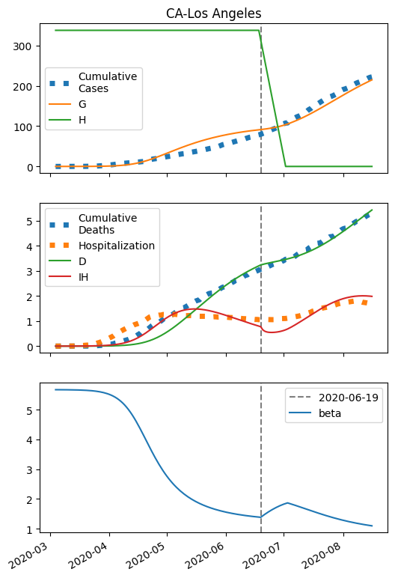
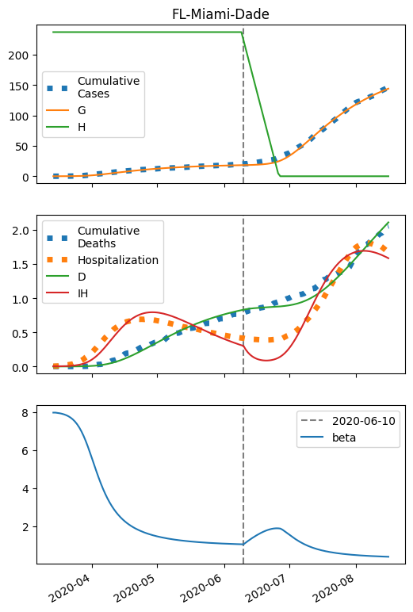
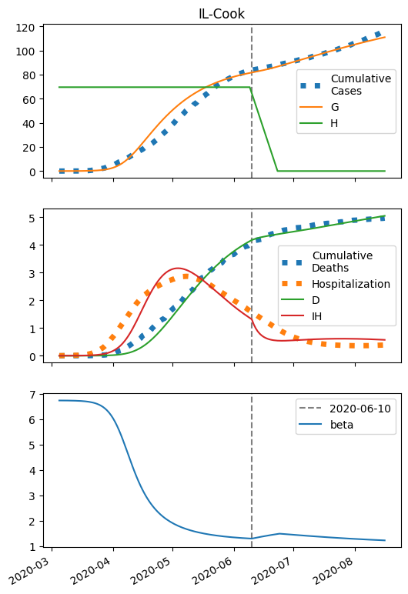
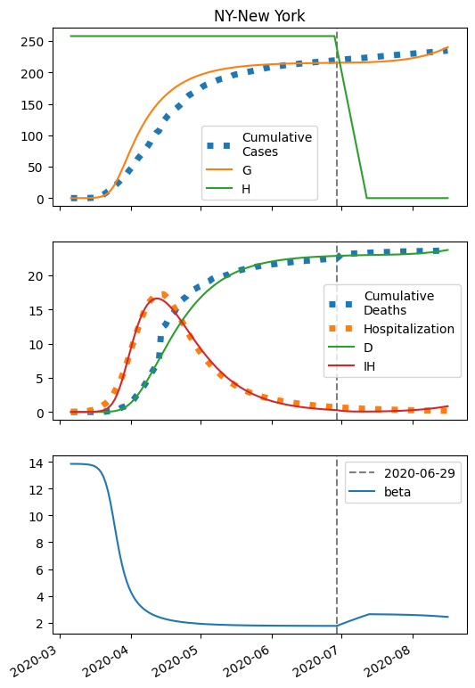
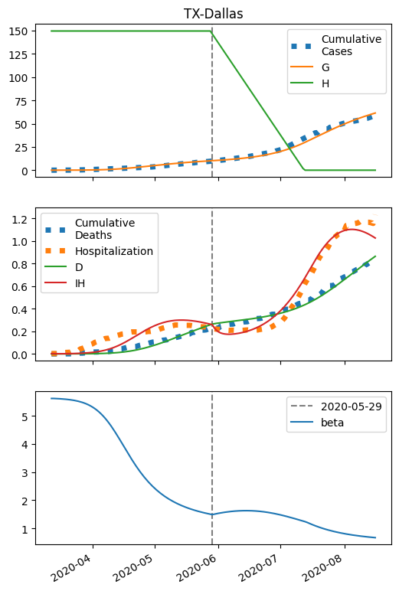
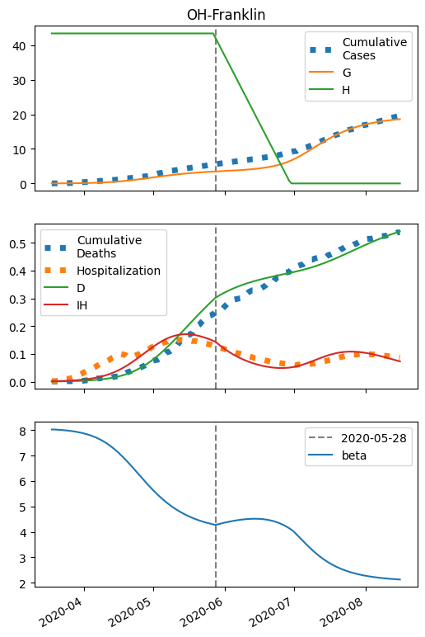
Preliminary Fitting Results
Notes:
R2 score generally good (0.95) for G and D

Slide 7
Difficulties
Optimization method
More data sets to fit
Assumption of releasing mechanism
Beta function dropping too quickly
Notes:
Using scikit-learn which is a machine learning library. optimization method 'L-BFGS-B’ with randomized initial point
Fitting G alone is relatively easy while as we add D and IH into the picture difficult to satisfy all sets. Weighting of data
Assuming a linear release. Forcing the release length 2 weeks

Slide 8
Future Work
More factors in beta function
More compartments (asymptomatic etc.)
Better phase division
Incorporating network travel model
Notes:
Weather, school, holiday, government requirements
Possible reinfection
Try different cutoff of the initial phase
Use air traffic data to construct a network model introducing import and export of cases

